Slide 1

An Introduction to my Text Mining Project on Zhu Fan Zhi诸蕃志
Jiating Liu

Slide 2

Contents
Part 1: What questions I am pursuing by processing?
Part 2: What answers I have so far?
Part 3: What are my next steps?

Slide 3
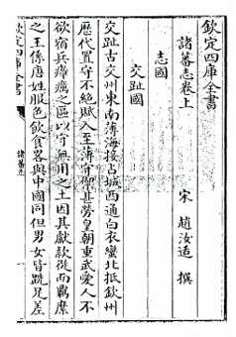
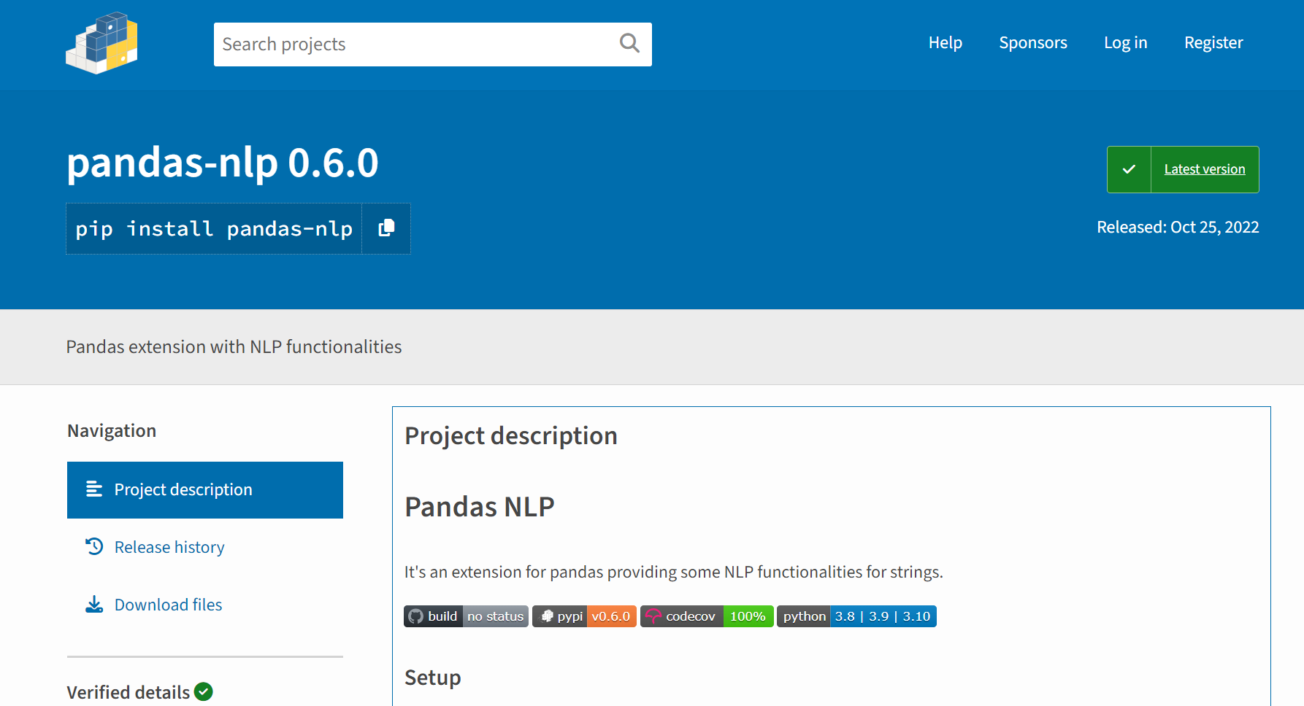
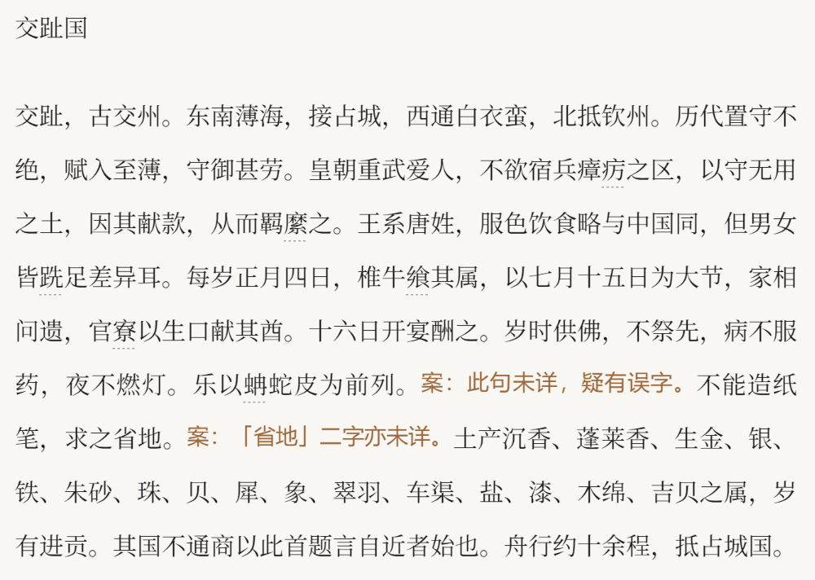
Part1: What questions I am pursuing by processing?
Part1: What is my source? Why did I choose it?
Topic Analysis (LDA)
High-Frequency Word
Word Segmentation
Word Filtering
Stop-word List
Zhufanzhi Special Dictionary
Panda NLP

Slide 4
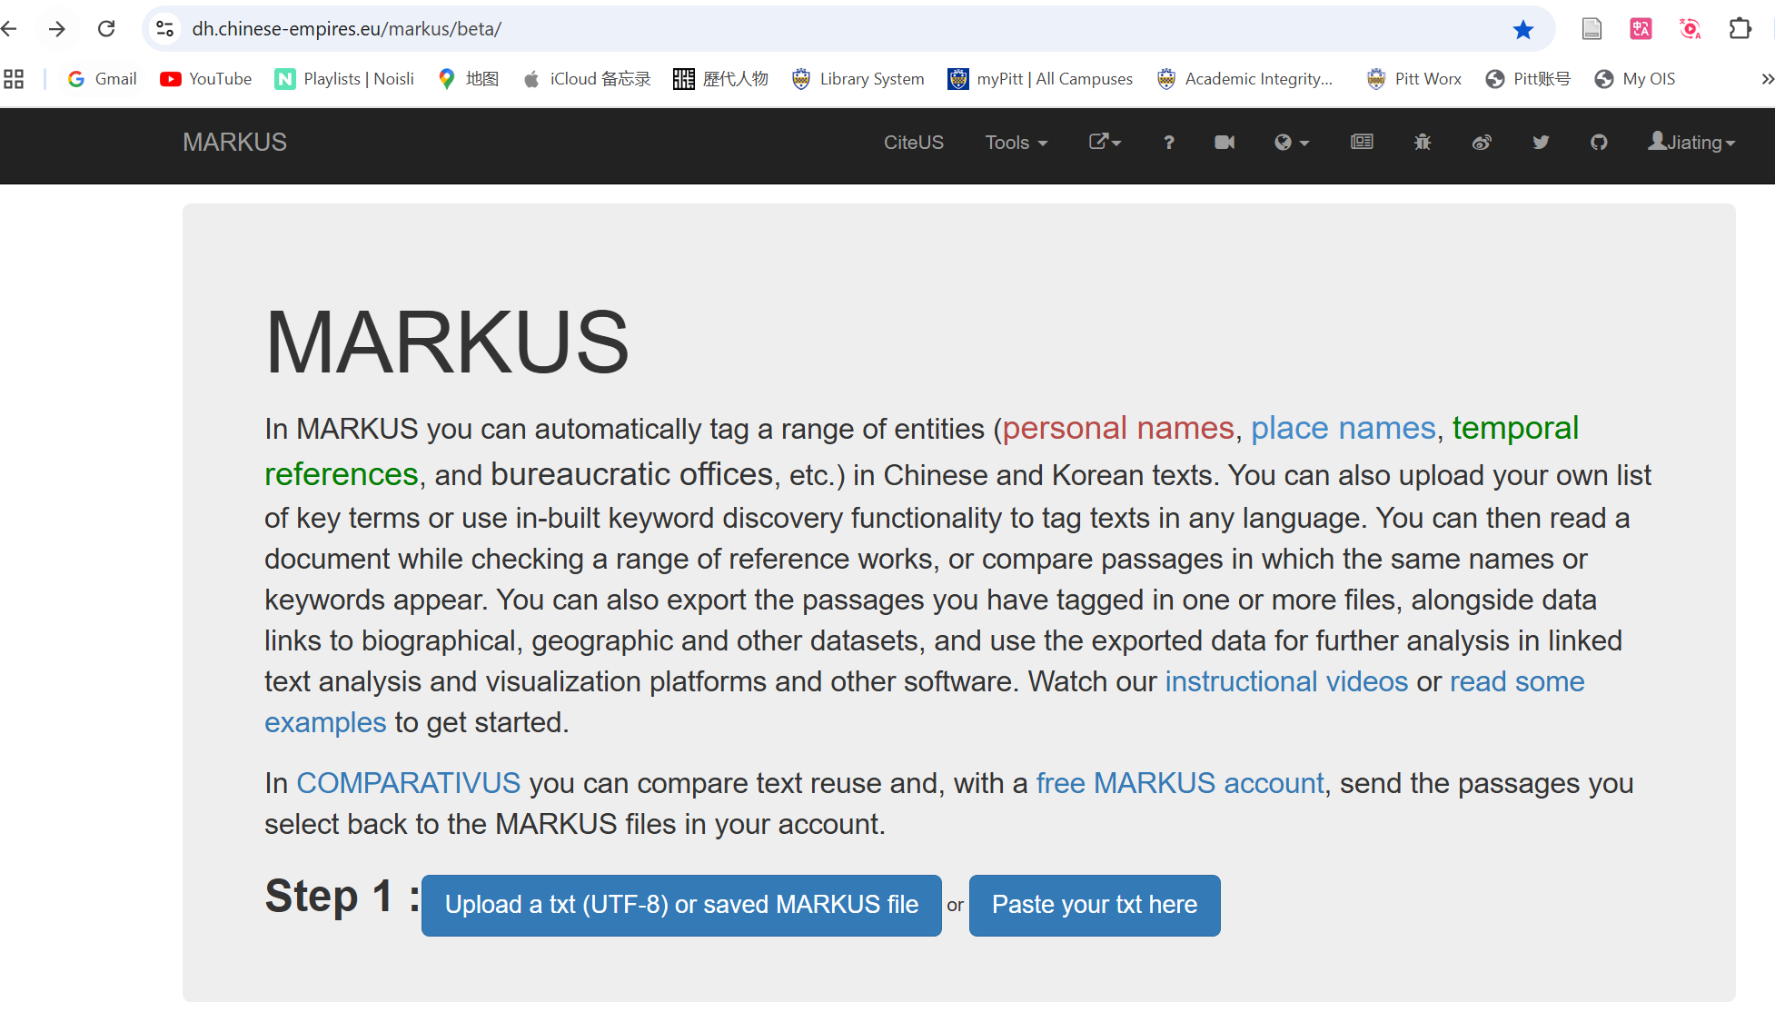
Part 2: What answers I have so far?
Part1: What is my source? Why did I choose it?

Slide 5
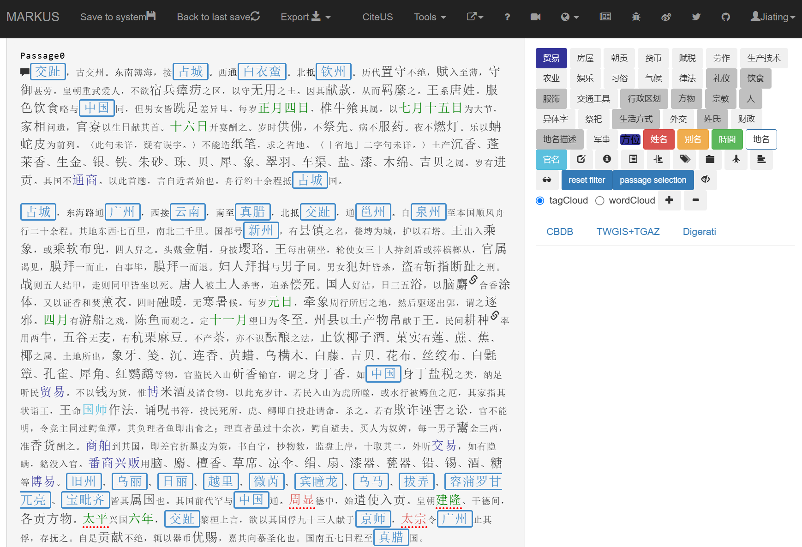
Part 2: What answers I have so far?
Part1: What is my source? Why did I choose it?

Slide 6
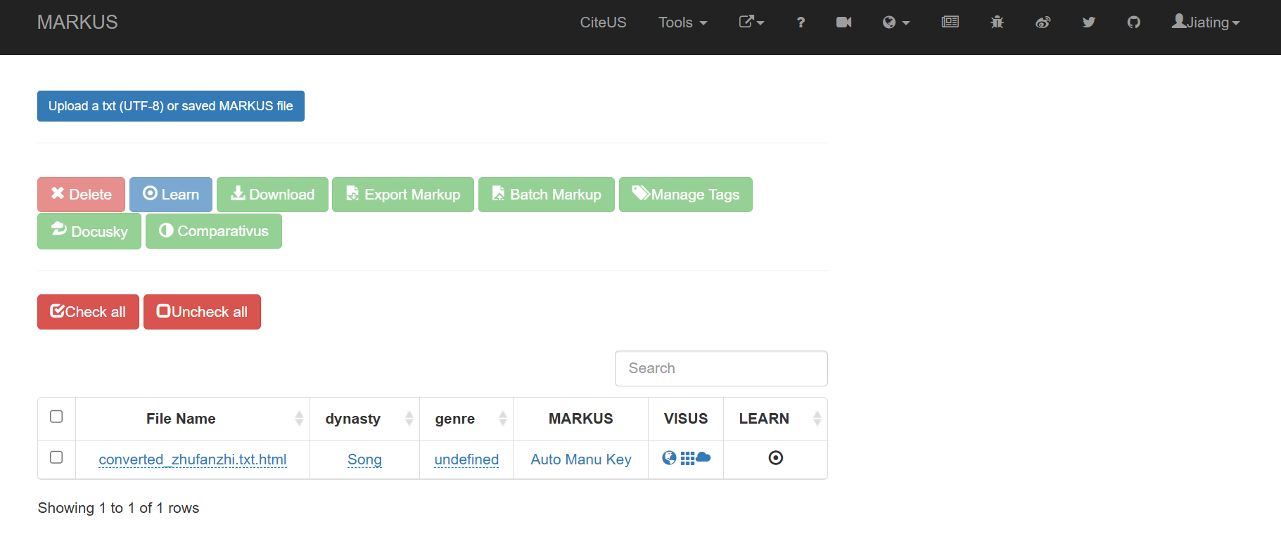
Part 2: What answers I have so far?
Part1: What is my source? Why did I choose it?

Slide 7
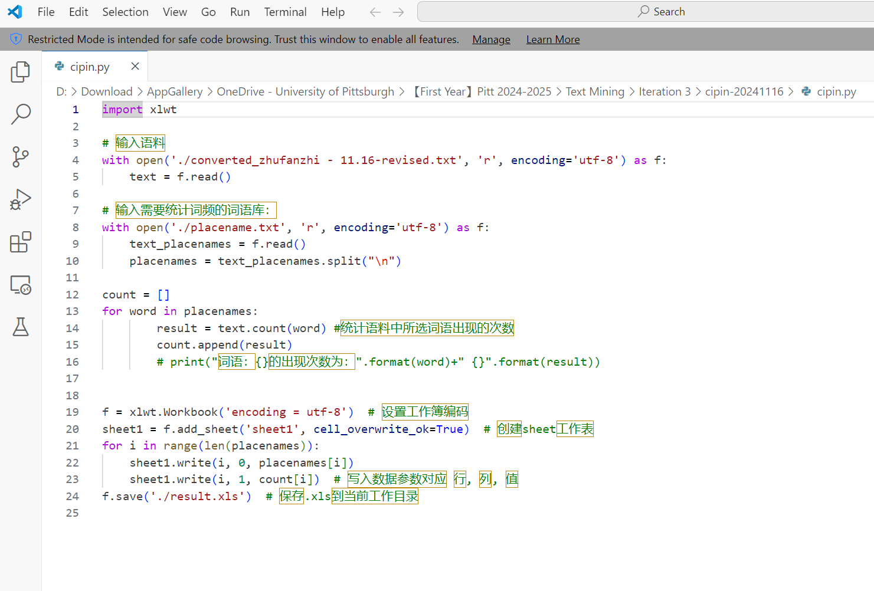
Part 2: What answers I have so far?
Part1: What is my source? Why did I choose it?

Slide 8
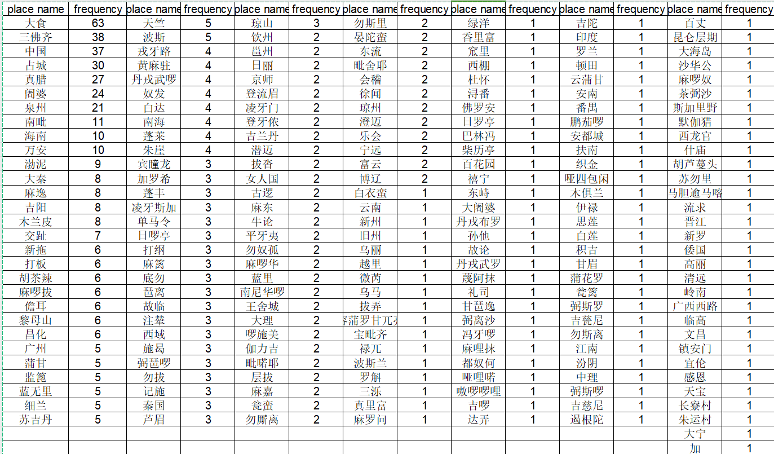
Part 2: What answers I have so far?
Part1: What is my source? Why did I choose it?

Slide 9
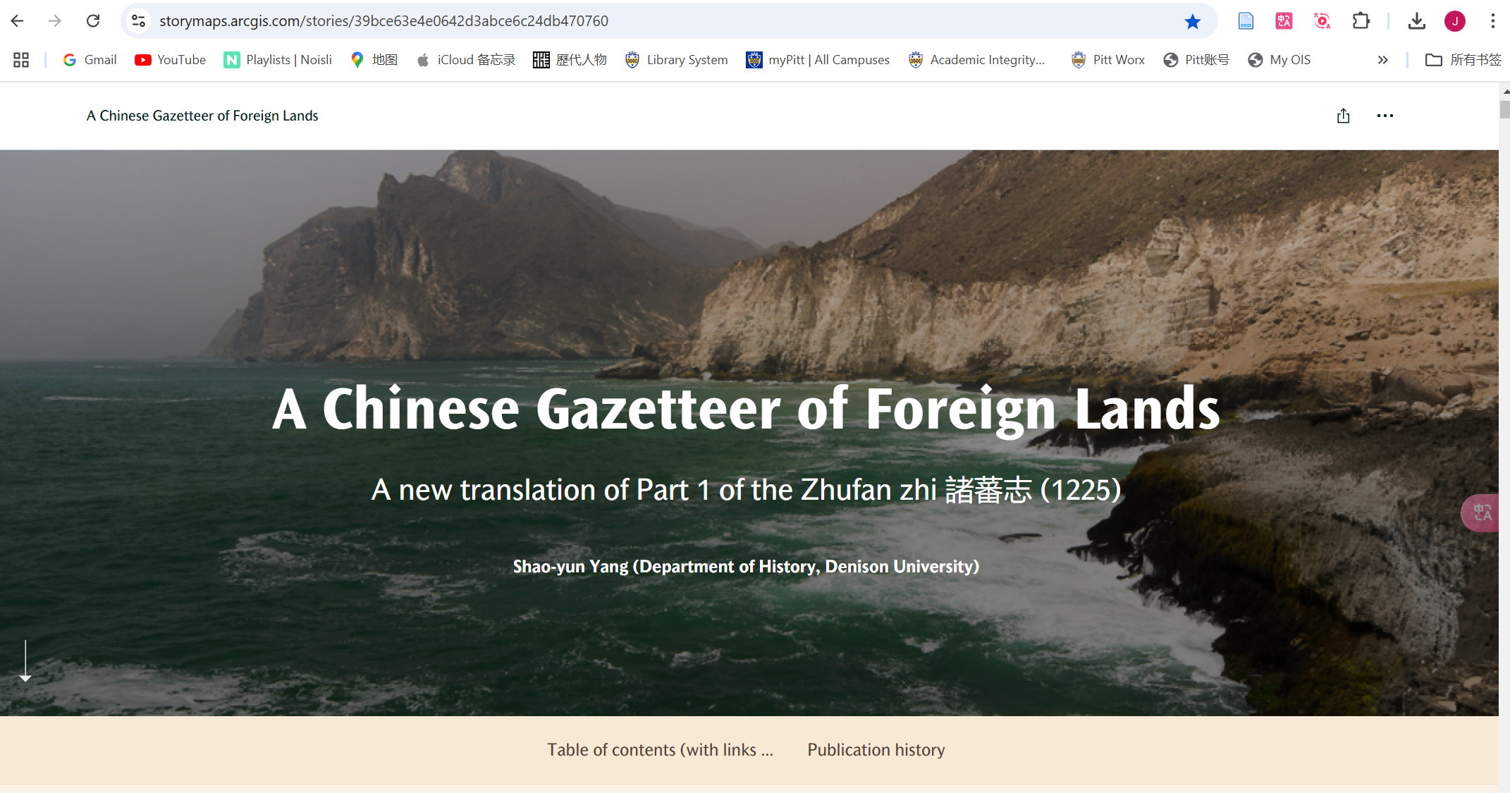
Part 2: What answers I have so far?
Part1: What is my source? Why did I choose it?

Slide 10
Part 2: What answers I have so far?
Part1: What is my source? Why did I choose it?

Slide 11
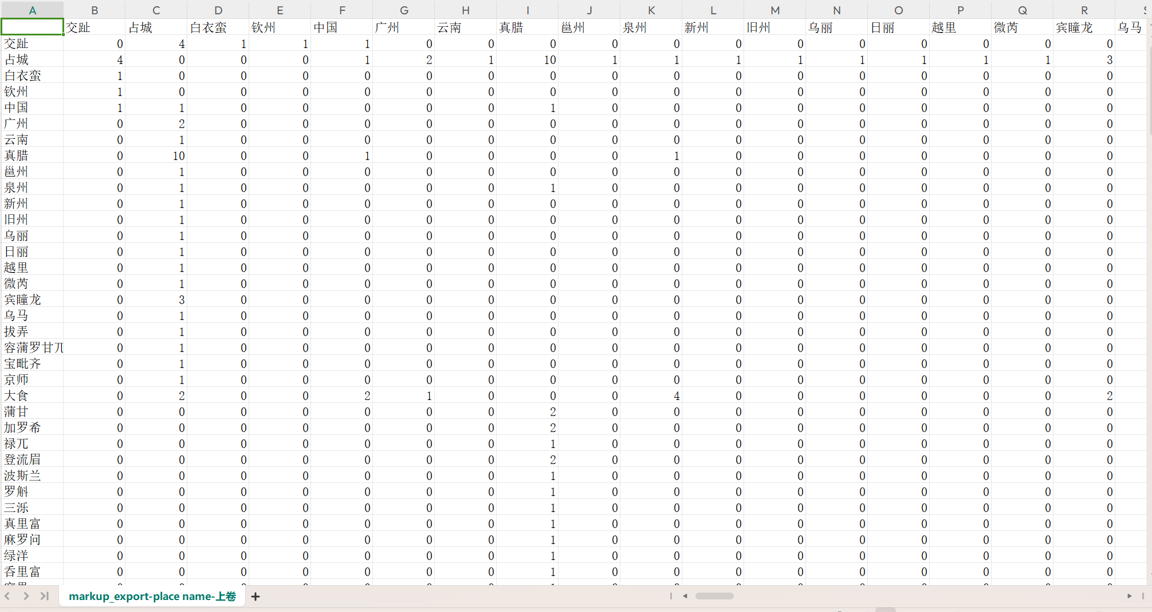
Part 2: What answers I have so far?
Part1: What is my source? Why did I choose it?

Slide 12
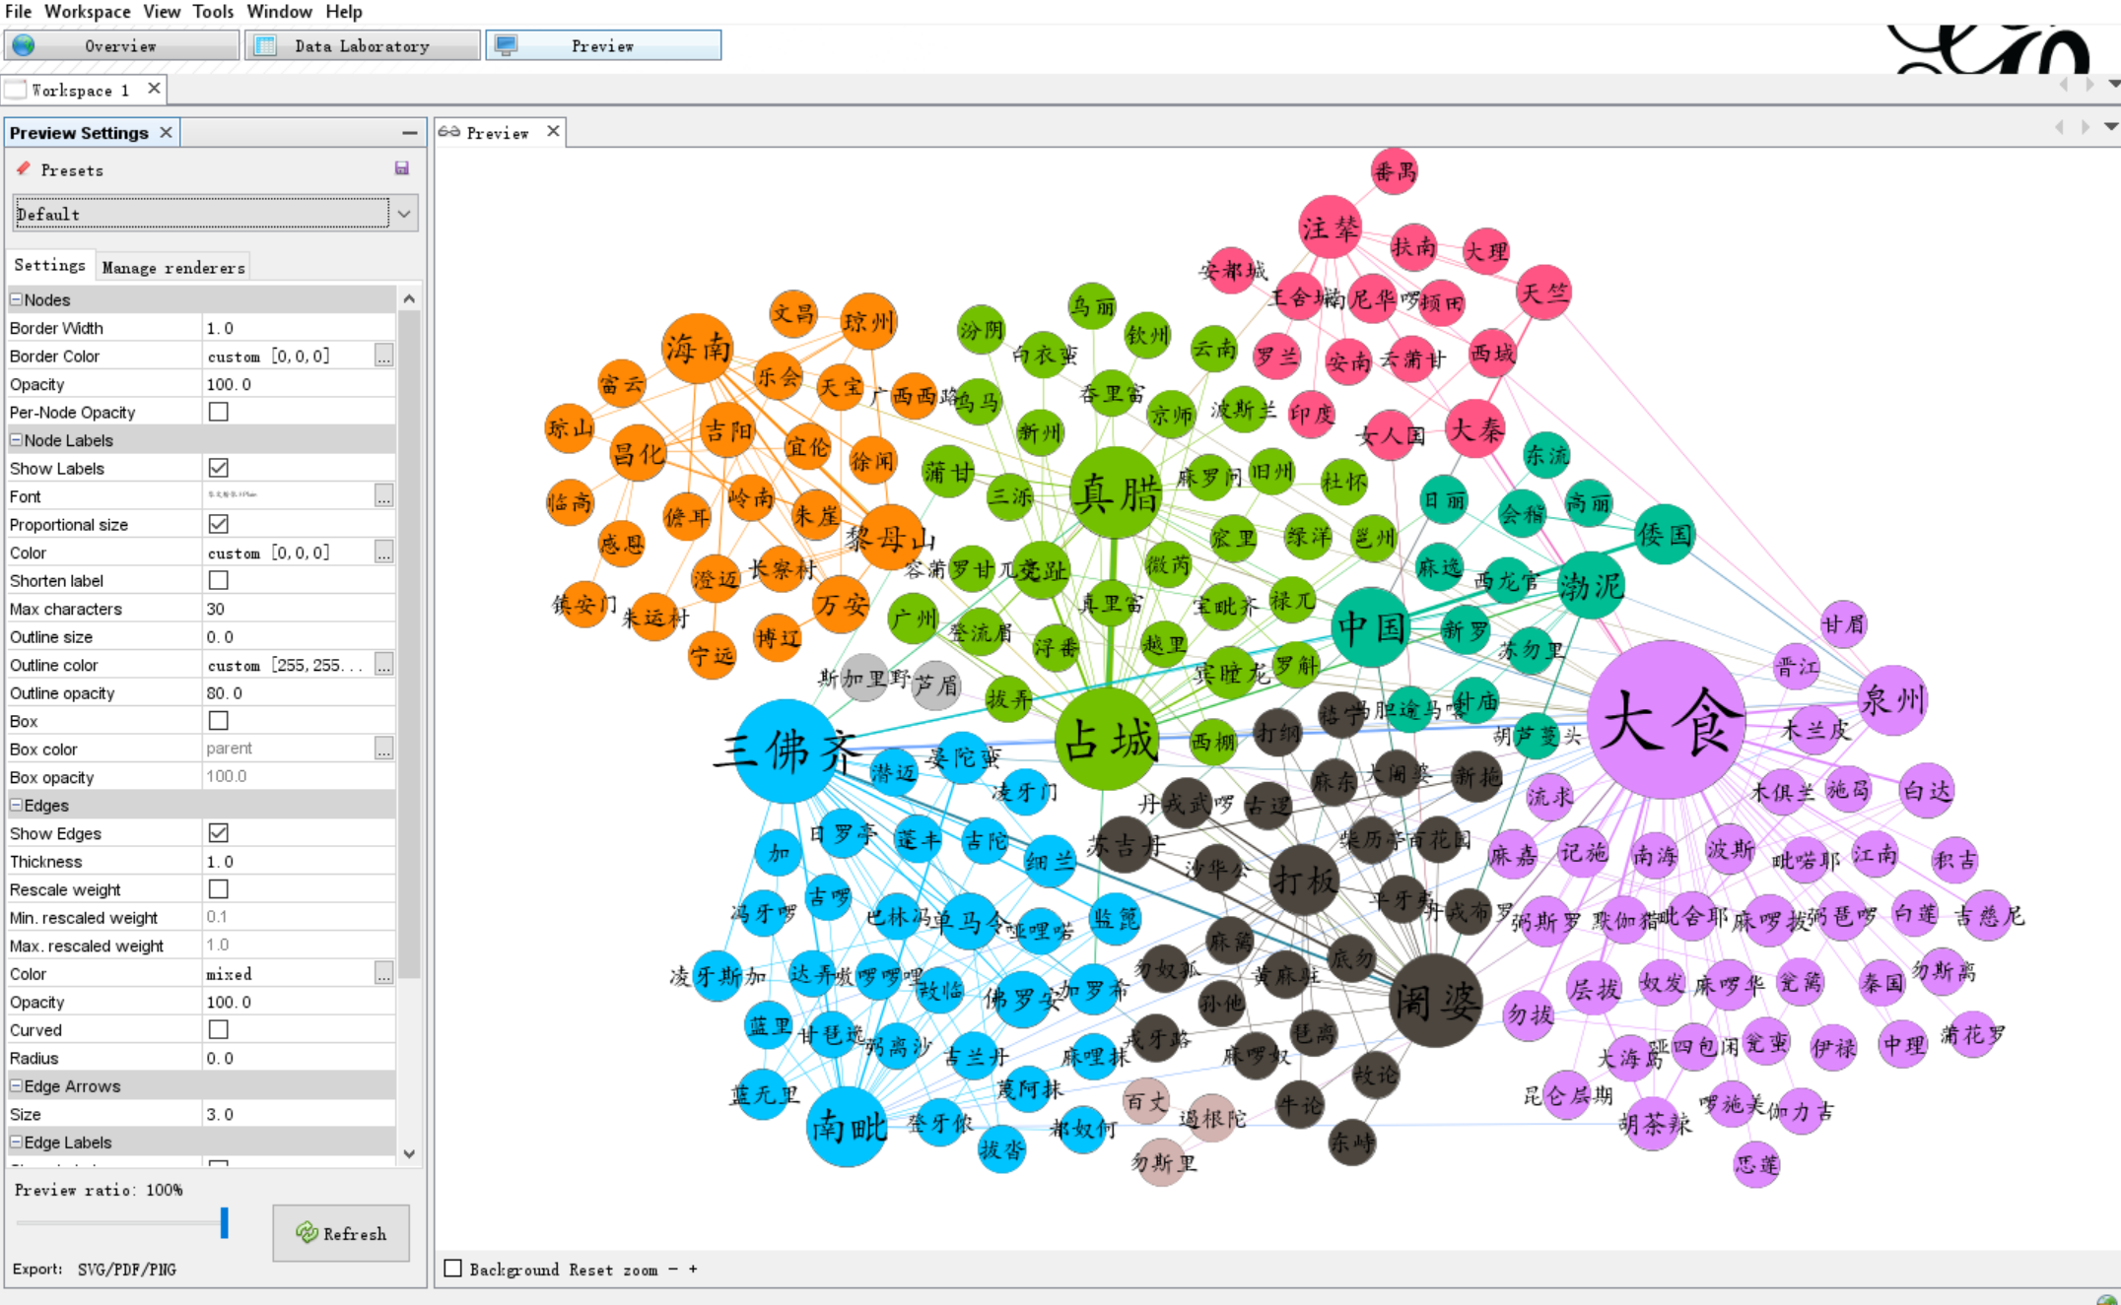
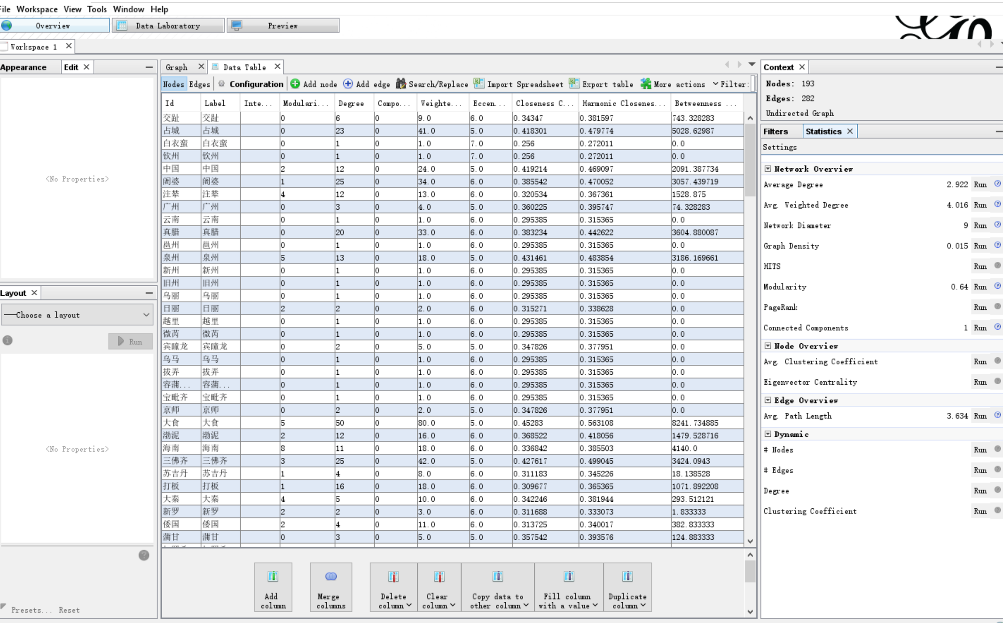
Part 2: What answers I have so far?
Part1: What is my source? Why did I choose it?

Slide 13
Part1: What is my source? Why did I choose it?
Part 3: What are my next steps?
Next Iteration?

Slide 14
Part1: What is my source? Why did I choose it?
Please Give Me Some Feedbacks!

